Slide 1
How Are We Doing in Behavioral Health?
A Policy Potpourri
New York Academy of Medicine

Slide 2
Presenters
Harold Alan Pincus MD
  Vice Chair Psychiatry, Columbia/Director Quality and Outcomes Research NewYork-Presbyterian
Sherry Glied PhD
  Dean, Wagner School NYU
Henry Chung MD
  VP/CMO, Montefiore Care Management Program and Einstein Faculty
Paul Appelbaum MD
  Professor Psychiatry, Law, Medicine Columbia

Slide 3
A Policy Potpourri
Parity of Insurance Benefits: Is the ACA Changing the World of Behavioral Health?
Integration of Behavioral Health and General Health: Drowning in the Mainstream or Left on the Banks?
The Promise of New Technologies for Behavioral Health…...And the Risks
Can Behavioral Health Cross the Quality Chasm ?

Slide 4
A Reality Check
How do YOU choose a doctor for yourself, your family, your Mom and Dad?
How do YOU choose a mental health provider for yourself or suggest one for a friend or a family member?
How do YOU determine whether you, your family, your Mom and Dad are receiving high quality medical care?
High quality mental health care?
What DATA do you examine to answer these questions?

Slide 5

Crossing the Quality Chasm
“Quality problems occur typically not because of failure of goodwill, knowledge, effort or resources devoted to health care, but because of fundamental shortcomings in the ways care is organized”
The American health care delivery system is in need of fundamental change. The current care systems cannot do the job.
Trying harder will not work:
Changing systems of care will!
5

Slide 6

6

Slide 7

Committee on Developing Evidence-Based Standards
for Psychosocial Interventions for Mental Disorders

Slide 8

“Crossing the Quality Chasm”
8
Notes:
8

Slide 9
Top Ten Most Common Medicaid Readmissions
1. Septicemia (except in labor) — $319 million (17,600 total readmissions)
2. Schizophrenia and other psychotic disorders — $302 million (35,800 total readmissions)
3. Mood disorders — $286 million (41,600 total readmissions)
4. Congestive heart failure (nonhypertensive) — $273 million (18,800 total readmissions)
5. Diabetes mellitus with complications — $251 million (23,700 total readmissions)
6. Chronic obstructive pulmonary disease and bronchiectasis — $178 million (16,400 total readmissions)
7. Alcohol-related disorders — $141 million (20,500 total readmissions)
8. Other complications of pregnancy — $122 million (21,500 total readmissions)
9. Substance-related disorders — $103 million (15,200 total readmissions)
10. Early or threatened labor — $86 million (19,000 total readmissions)
* AHRQ Statistical Brief

Slide 10
Follow-up after Hospitalization for Mental Illness within 7 Days (HMOs only) 2003-2012
(NCQA October 2013)

Slide 11
ACA Quality Reporting/Payment Programs with BH Measures
Physicians Quality Reporting System/MIPS
Meaningful Use
Value Based Payment Modifier
PhysicianCompare.Gov
Inpatient Psychiatry Quality Reporting Program
HospitalCompare.Gov
NursingHomeCompare.Gov
State Medicaid Reporting Programs

Slide 12

Care of mentally ill faulted in report
US survey reviews patient follow-up; state well below national average
Medicare data on hospitalcompare.gov highlights poor performance of individual hospitals

Slide 13
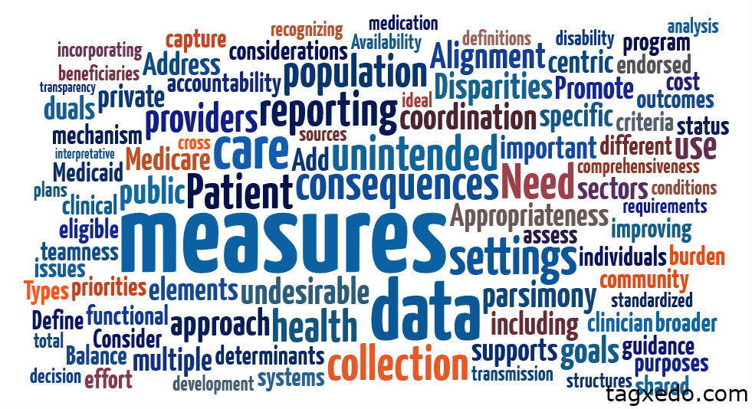
13

Slide 14
State of Behavioral Health Quality Measurement and Improvement
Few endorsed measures
Most focus on processes quite distal from outcomes (e.g., screening/assessment)
Major gaps – child disorders, substance abuse, psychosocial interventions, PROs
Outcomes measurement not widely applied despite reliable/valid instruments (“measurement-based care”)
Proven QI methods not permeating routine operations
Work force not trained in quality measurement and improvement

Slide 15
“Quality Measurement Industrial Complex” Process
Establishing an evidence base
Translating evidence to guidelines
Translating guidelines to measure concepts
Operationalizing concepts to measure specifications (numerator/ denominator)
Testing for reliability, validity, feasibility
Endorsement/Adoption
Aligning measures across multiple programs
Stewardship/Updating measures over time
15

Slide 16
Challenges
Limitations in the evidence base
Gaps in health information technology and behavioral health informatics- HITECH Act
Navigating the “Quality Measurement Industrial Complex”
  No national locus for leadership/stewardship
Multiple non-collaborating disciplinary organizations
Unclarity of accountability (BH/PC, inpt/outpt)
Capacity to quit the game

Slide 17

Fewer Psychiatrists Seen Taking Health Insurance
WASHINGTON — Psychiatrists are significantly less likely than doctors in other specialties to accept insurance, researchers say in a new study, complicating the push to increase access to mental health care.
http://www.nytimes.com/2013/12/12/us/politics/psychiatrists-less-likely-to-accept-insurance-study-finds.html?_r=0

Slide 18
Some Questions for Discussion
Does insurance + parity = access? What other strategies are needed to fill gaps?
As we move toward ”value-based” payment strategies, how do we assess “value” in BH? What quality measures are needed?
What are the barriers to bridging the silos of mental health, substance abuse, primary care and social services? How can we overcome them?
How can BH enter the 21st century in using health information (and other) technologies? What are the risks and benefits?
What constitutes a balanced portfolio of research investments in BH research? What are the most important priorities?
Under what policy circumstances should there be BH “exceptionalism”? What is the justification?
Can we come up with a better term than “Behavioral Health”?

Slide 19
Back Up Slides

Slide 20
Antidepressant Medication Management: Continuation Phase- HMO Means
Trends, 2002-2009

Slide 21
“Players” in the Quality Measurement Industrial Complex
Evidence Developers
  Researchers, NIH, PCORI, AHRQ
Guideline Developers
  Professional Associations
Measure Developers/Stewards
  NCQA, TJC, CMS, Contractors, Researchers, AMA?
Measure Endorsers
  NQF, MAP
Measure Users
  CMS, Plans, Provider Organizations, Media, Public

Slide 22
Preparing for the Future
Consumer Participation
Standardize Practice Elements
  Clinical/Diagnostic Assessment
  Interventions
  IT Infrastructure
Develop Guidelines
  Evidence-Based
  Trustworthy
  Within/Across Specialties
Measure Performance
  Can’t improve without measuring
  Across silos and levels
Improve Performance
  Learn
  Reward
Strengthen Evidence Base
  Validate Measures
  Evaluate effective QI strategies
  Translate from bench to bedside to community
Administrative/ Academic Support
Clinical Perspectives
Integrative Processes
22

Slide 23
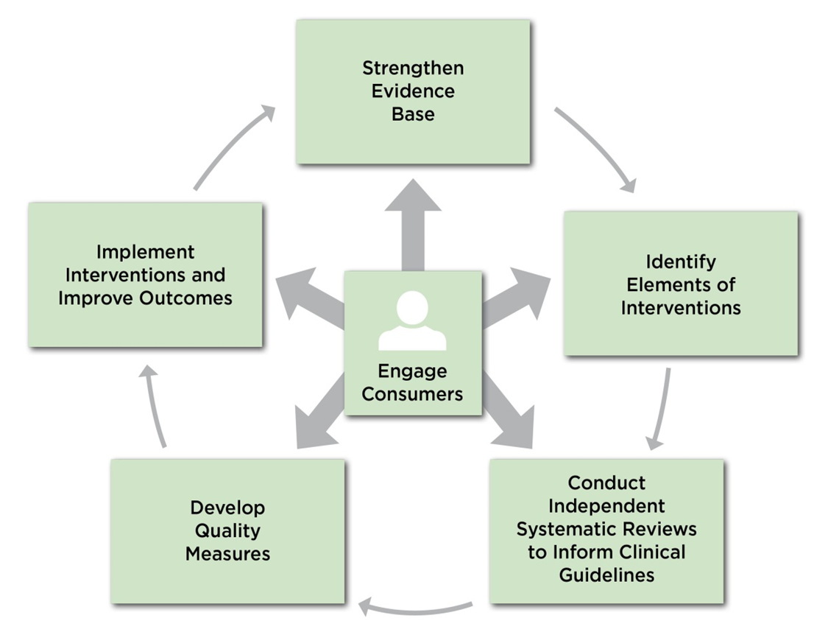
A Framework to Improve Quality
2015-2016 Harkness Fellows' Orientation Seminar September 15-18 in New York

Slide 24
IOM Report on Standards for Psychosocial Interventions
Framework to facilitate integration of evidence-based psychosocial interventions into clinical practice:
Support research to strengthen the evidence base on efficacy and effectiveness of psychosocial interventions.
Based on this evidence, identify key elements that drive the effect of an intervention.
Conduct systematic reviews to inform clinical guidelines that incorporate these key elements.
Using the findings of these systematic reviews, develop quality measures—ie, measures of the structure, process, and outcomes of interventions.
Establish methods for successfully implementing, incentivizing and sustaining these interventions in regular practice as part of Learning Healthcare Systems, including the training of practitioners in the use of these interventions.

Slide 25
Current State of Behavioral Health Quality Measures - Overview
NBHQF priority area, domain, and subdomain | N | Endorsed by NQF (N) | Endorsed by NQF (%)
Total | 510 | 53 | 10
Effective treatment | 147 | 19 | 13
Person or family centered | 32 | 1 | 3
Coordination | 78 | 6 | 8
Healthy living | 129 | 24 | 19
Safe | 60 | 2 | 3
Affordable- accessible | 64 | 1 | 2
Source: Patel, Brown, Croake et al, The Current State of Behavioral Health Quality Measures: Where are the Gaps? PsychServ 66:8, Aug 2015, 865-871

Slide 26
Current State of Behavioral Health Quality Measures – Overview (cont.)
Condition | Measures (N) | Measures (%) | NQF endorsed (N) | NQF endorsed (%)
Depression | 111 | 22 | 13 | 24
Schizophrenia | 62 | 12 | 6 | 11
Tobacco use | 63 | 12 | 8 | 15
Alcohol use | 59 | 12 | 8 | 15
Drug use | 54 | 11 | 4 | 7
Bipolar disorder | 33 | 6 | 4 | 7
PTSD | 22 | 4 | 0 | -
ADHD | 10 | 2 | 1
>1 MH or SUD | 161 | 32 | 12 | 22
Other | 7 | 1 | 0 | -

Slide 27
Current State of Behavioral Health Quality Measures – Overview (cont.)
Data source | Measures (N) | Measures (%) | NQF endorsed (N) | NQF endorsed (%)
Adm claims or pharmacy data | 452 | 89 | 48 | 89
Medical records | 348 | 68 | 31 | 57
Patient survey | 60 | 12 | 4 | 7
Provider survey | 15 | 3 | 0 | -
EHR | 8 | 2 | 5 | 9

Slide 28
Measurement-Based Care (MBC)
Systematically apply appropriate clinical measures
  e.g. HA1c, PHQ-9, Vanderbilt Assessment Scales
  Create a measurement tool kit
Assure consistent, longitudinal assessment
  “Ruthless” Follow-Up/Care Management
Use action-oriented menu of evidence-based options
  Treatment intensification/“Stepped Care”
Establish practice-based infrastructure
  Build IT/Registry Capacity
Enhance Connectivity among Systems
  MH/PC/SUD/Social Services/Education
Incentivize Structures that Produce Outcomes

Slide 29
Top Ten List of Best Practices
Population Management/Predictive Modeling*
Formal linkages with:
  Primary Care
  Substance Abuse
  Social Services
Effective Teams/Communication*
Effective Implementation Strategies to Assure:
  Access to Evidence-Based Psychosocial Services
  Access to Evidence-Based Mediation Strategies
Decision Support for Measurement-Based/Stepped Care
Care Management with Relentless Follow-Up*
Clinical Registries for Tracking and Coordination*
Recovery-Oriented, Shared Decision-making/Self Management Tools and Services
Data-Driven Quality Measurement and Improvement*
Health Information Technology Support*

